Slide 1

BACHELOR OF TECHNOLOGY
IN
Artificial Intelligence and Machine Learning
Batch Number: BT5
Project Guide: Project Title :TextExtraction from Images
Prof. Sivakumar
Assistant professor
Batch Names & Roll Numbers
2211CS020112 :D.SREE LASYA
2211CS020114 :D.TRISHUL
2211CS020115 :D.SRIMANTH
2211CS020116 :D.SAI MOURYA SRI
2211CS020117 : D.SHIVA RAJ
Department of AIML, School of Engineering
Malla Reddy University Hyderabad.
Department of AIML, School of Engineering
Malla Reddy University Hyderabad.

Slide 2
ABSTRACT
Text extraction from images is a crucial technique in the fields of computer vision and optical character recognition (OCR). It enables the conversion of textual information embedded within images into machine-readable formats, facilitating tasks such as data digitization, document analysis, and automated information retrieval. This process typically involves image pre-processing, text detection, and text recognition stages. Various approaches, including traditional methods like edge detection and connected component analysis, as well as modern deep learning-based algorithms, such as convolutional neural networks (CNNs) and recurrent neural networks (RNNs), are employed to achieve high accuracy in diverse environments. Applications range from scanning historical documents to real-time text recognition in videos or mobile applications. However, challenges persist, particularly in handling low-quality images, complex backgrounds, and non-standard fonts. This paper explores the latest methodologies, tools, and frameworks developed to optimize text extraction, evaluating their effectiveness across a variety of datasets and use cases.

Slide 3
Literature Survey
Introduction: Text extraction from images is a crucial technology in the modern digital landscape, impacting various sectors including document management, data entry, and accessibility. Efficiently converting printed or handwritten text into digital format can enhance information retrieval and processing.
Advanced methods:
CNN:CNNs are used for both text detection and recognition tasks. For text recognition, CNNs extract features from image patches that represent characters or words. They are particularly useful for recognizing characters in varying fonts and sizes.
CRNN:A combination of CNNs for feature extraction and RNNs (usually LSTMs) for sequence prediction is commonly used in OCR for recognizing characters in sequence without the need for predefined segmentation.
Future Directions:
End-to-end systems,Use of Transformers,Post Processing with NLP,Synthetic data for training, Mobile and edge device optimization.
Conclusion:The field of text extraction from images has seen remarkable advancements with the advent of sophisticated technologies. For initiatives focusing on efficient data management, integrating cutting-edge OCR techniques with advanced image preprocessing and machine learning methods presents a promising strategy. Ongoing research and development are crucial for refining these systems to enhance accuracy, scalability, and sustainability. As technology continues to evolve, it will be essential to balance innovation with practical implementation to optimize text extraction processes across various applications.

Slide 4
Problem Statement
Problem Statement: Accurate text extraction from images is challenging due to variations in fonts, backgrounds, and image quality. A robust solution is needed to handle diverse conditions and improve extraction accuracy. The goal is to develop a system that seamlessly integrates into existing workflows with minimal manual intervention.

Slide 5
Data Collection and Exploration ​
Data collection and exploration for text extraction from images are critical steps in developing effective OCR systems. The process begins with gathering a diverse dataset of images that contain text, sourced from scanned documents, photographs, and screenshots. This dataset should encompass various fonts, sizes, and backgrounds to ensure robustness. Once collected, images are annotated with their corresponding text, which can be done manually or with semi-automated tools.
Preprocessing is essential to enhance image quality, involving steps like resizing, noise reduction, and converting to grayscale. Exploratory data analysis (EDA) helps identify patterns and challenges within the dataset, guiding necessary adjustments. Finally, evaluating the dataset with test images ensures that the OCR system can generalize well to unseen data, leading to improved accuracy in text extraction.

Slide 6
Data Preprocessing
Image Preprocessing Text Alignment: Apply perspective transformation to correct skewed text layouts, ensuring that text is presented in a standard orientation across images. Text Region Cropping: Isolate the regions containing text from images to focus the model on relevant areas and eliminate distractions from the background.
Data Augmentation: Implement techniques such as rotation, scaling, and synthetic noise addition to diversify the dataset, helping improve the robustness of the text recognition model.
Feature Scaling: Normalize the extracted features, such as pixel intensity values, to a common range, facilitating more effective training of text recognition models.
Noise Reduction: Utilize techniques such as Gaussian blur to minimize visual noise and improve the clarity of text in images. For images captured in poor lighting, enhance contrast to make the text more distinguishable.
Outlier Removal: Identify and filter out images that contain excessive distortion or artifacts that could hinder the accuracy of text recognition.

Slide 7
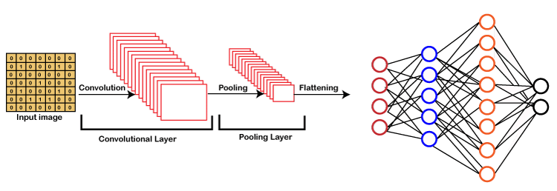
Model Selection
Convolutional Neural Network
Convolutional Neural Networks (CNNs) are a type of deep learning model designed specifically for processing grid-like data, such as images. They consist of layers that automatically detect important features like edges, textures, and patterns through the use of convolutional filters. CNNs are highly effective in tasks such as image classification, object detection, and text extraction due to their ability to capture spatial hierarchies in data. Key components of CNNs include convolutional layers, pooling layers, and fully connected layers, making them powerful for tasks requiring visual feature recognition.

Slide 8
Algorithms
Keras OCR is a Python library that simplifies the process of optical character recognition (OCR) using deep learning techniques. Built on top of Keras, it provides pre-trained models and tools to detect and recognize text in images. The library is designed for ease of use, allowing developers to quickly implement OCR in their applications with minimal setup. It supports various image formats and can be integrated into larger machine learning workflows. Keras OCR is particularly useful for tasks involving text extraction from images, such as document processing and scene text recognition.
Tesseract is an open-source optical character recognition (OCR) engine developed by Google, renowned for its ability to convert images of text into machine-readable text. Supporting over 100 languages and various character sets, Tesseract is celebrated for its high accuracy and versatility, making it suitable for diverse applications ranging from scanning printed documents to extracting text from complex images.Engine can be easily integrated with other software and tools, enhancing its functionality and usability. It supports a wide variety of image formats, including TIFF, PNG, and JPEG, allowing users to work with different data sources. Tesseract is widely employed in both academic research and commercial projects, establishing itself as go-to solution for various text recognition tasks.

Slide 9
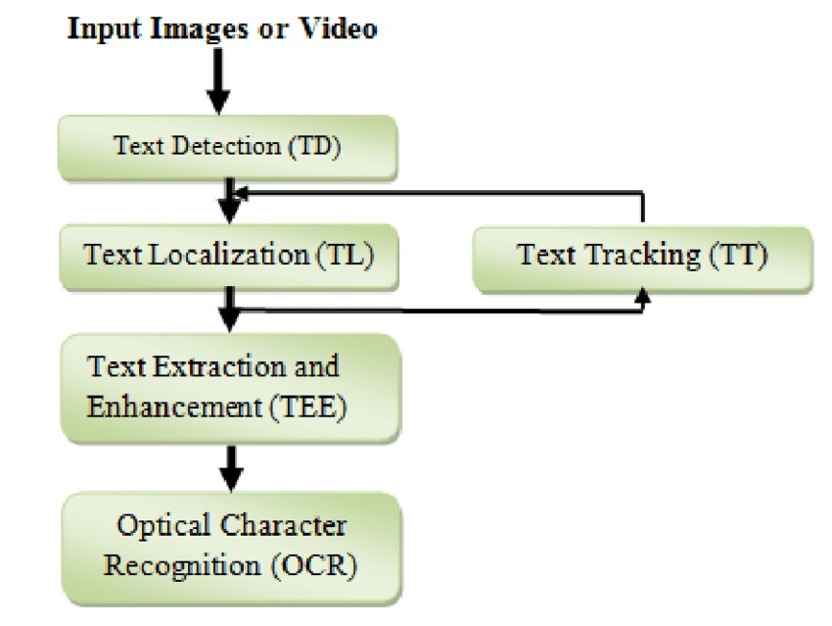
Architecture

Slide 10
Deployment and Results:
Model Deployment: The multimodal text extraction model is deployed using TensorFlow or PyTorch. A web application built with Flask or Django allows users to upload images for text extraction. Docker ensures consistent deployment across environments, and the application is hosted on a cloud service to provide scalability and accessibility.
Evaluation Metrics: Model performance is evaluated using metrics such as accuracy, precision, recall, and F1-score to assess the effectiveness of text extraction. A confusion matrix visualizes the results, and cross-validation techniques are employed to ensure the model can generalize well to new data.
Testing Methodologies: The model is tested on a labeled dataset that includes various images with annotated text. It utilizes the Holdout Method to split the data into training, validation, and test sets, along with K-Fold Cross-Validation to enhance robustness and reduce the risk of overfitting.
Results: Results are presented with images alongside their extracted text. The output showcases both successful extractions and errors, providing valuable insights into the model's performance and highlighting areas for further improvement.

Slide 11
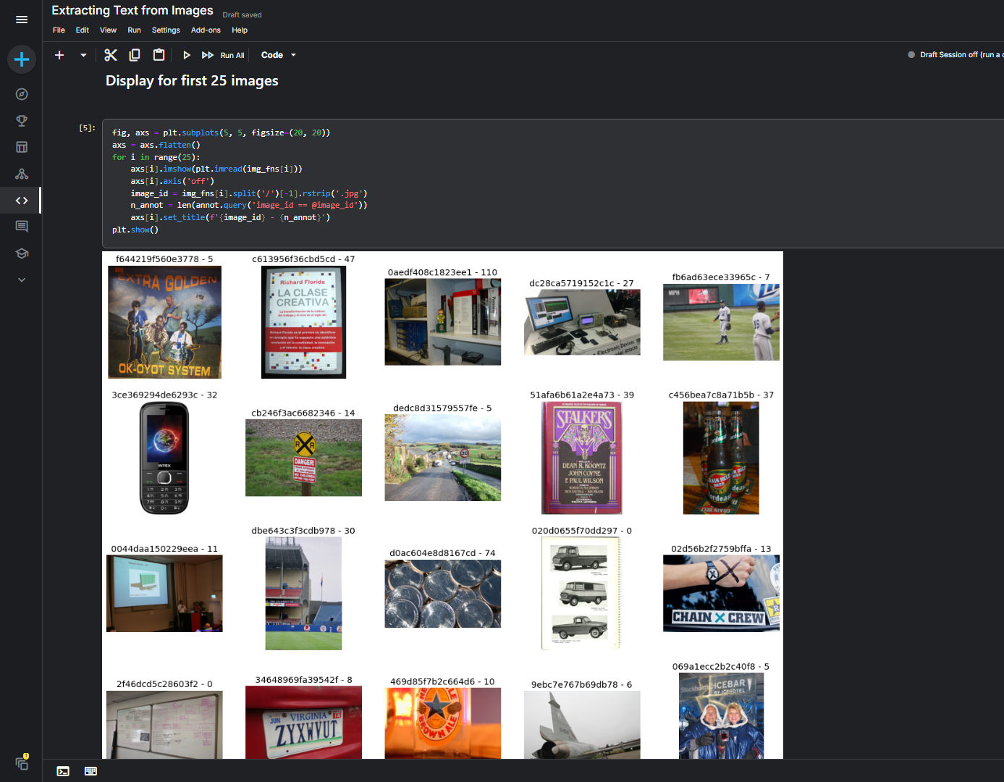
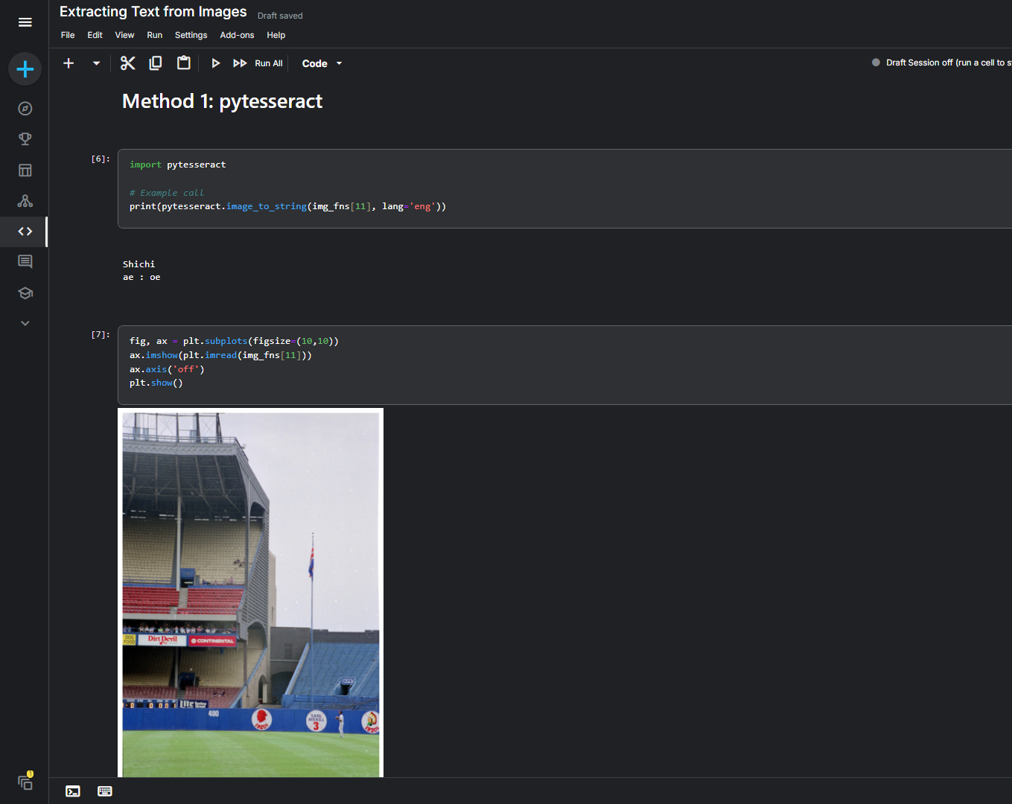
Dataset Images
Method 1: pyTesseract

Slide 12
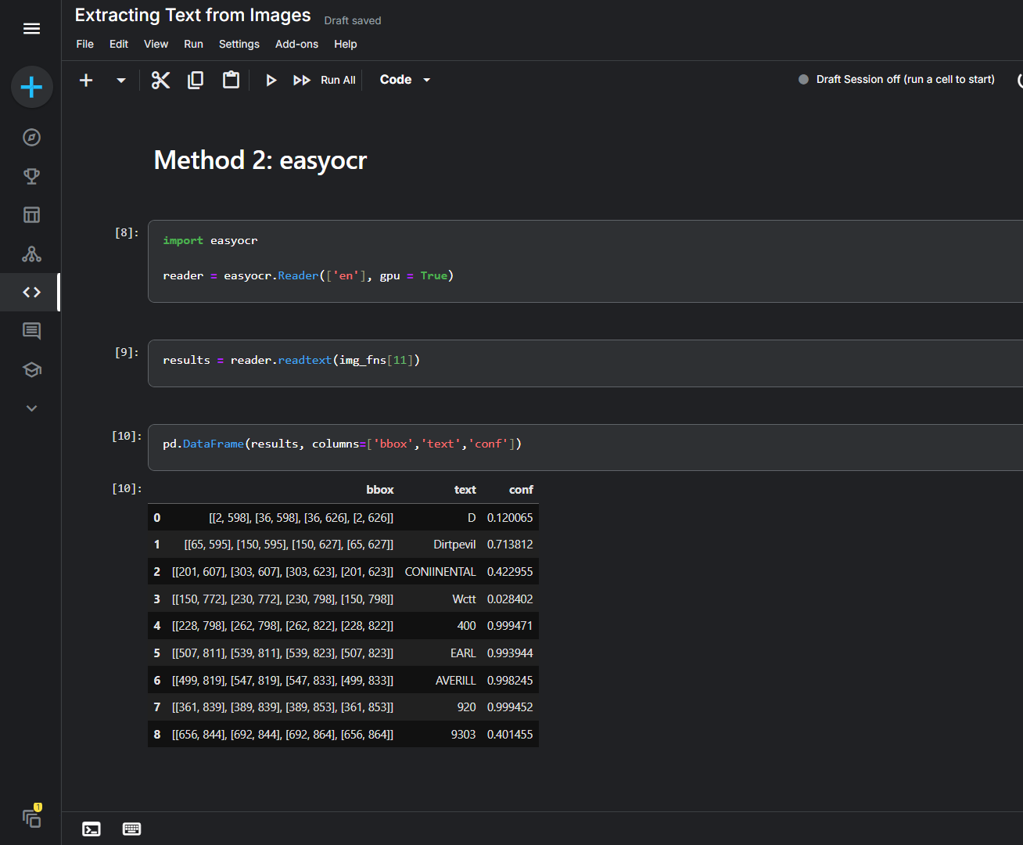
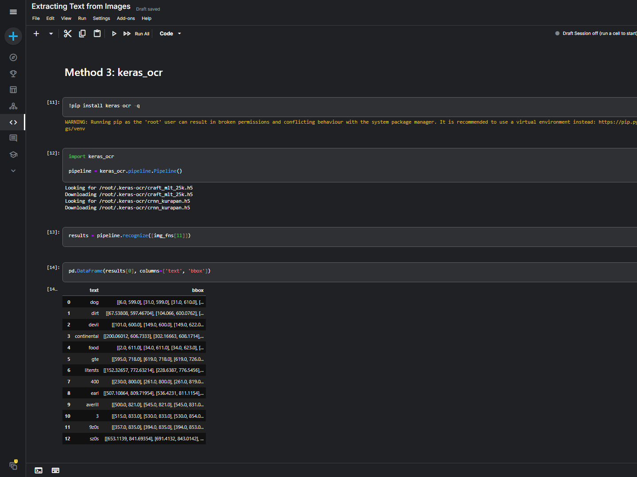
Method 2: EasyOCR
Method 3: KerasOCR

Slide 13
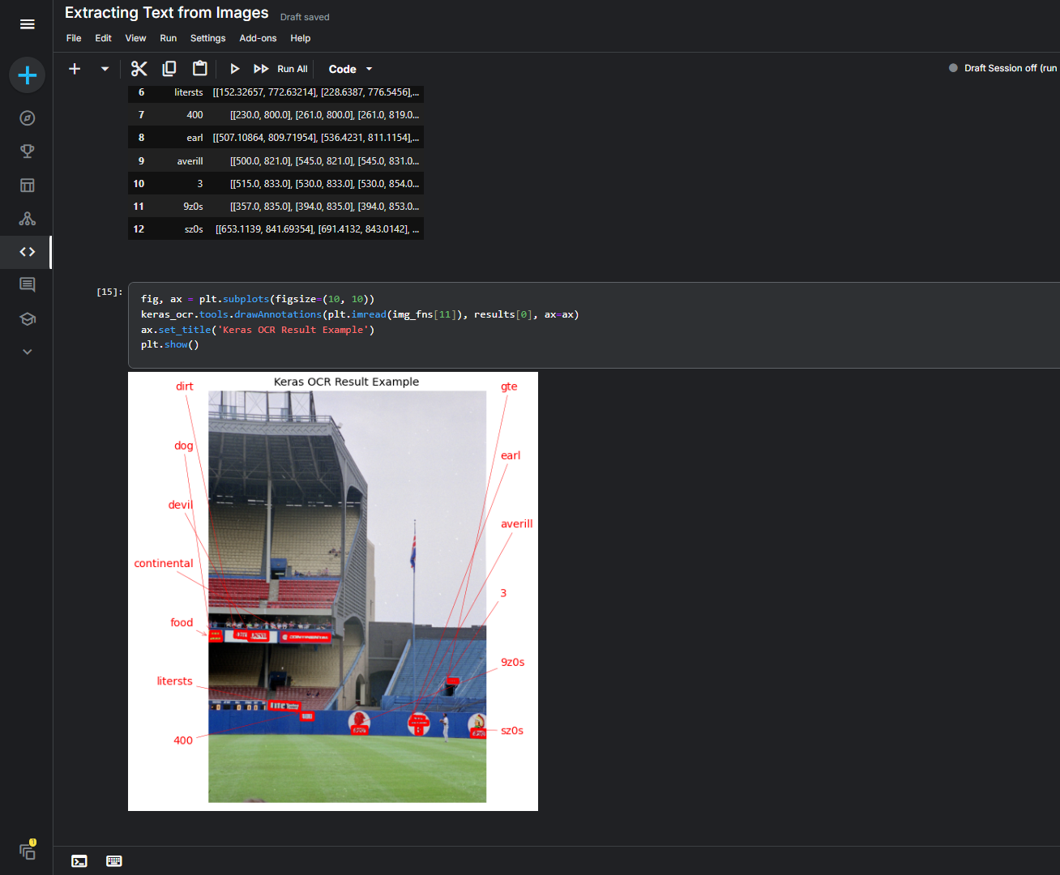
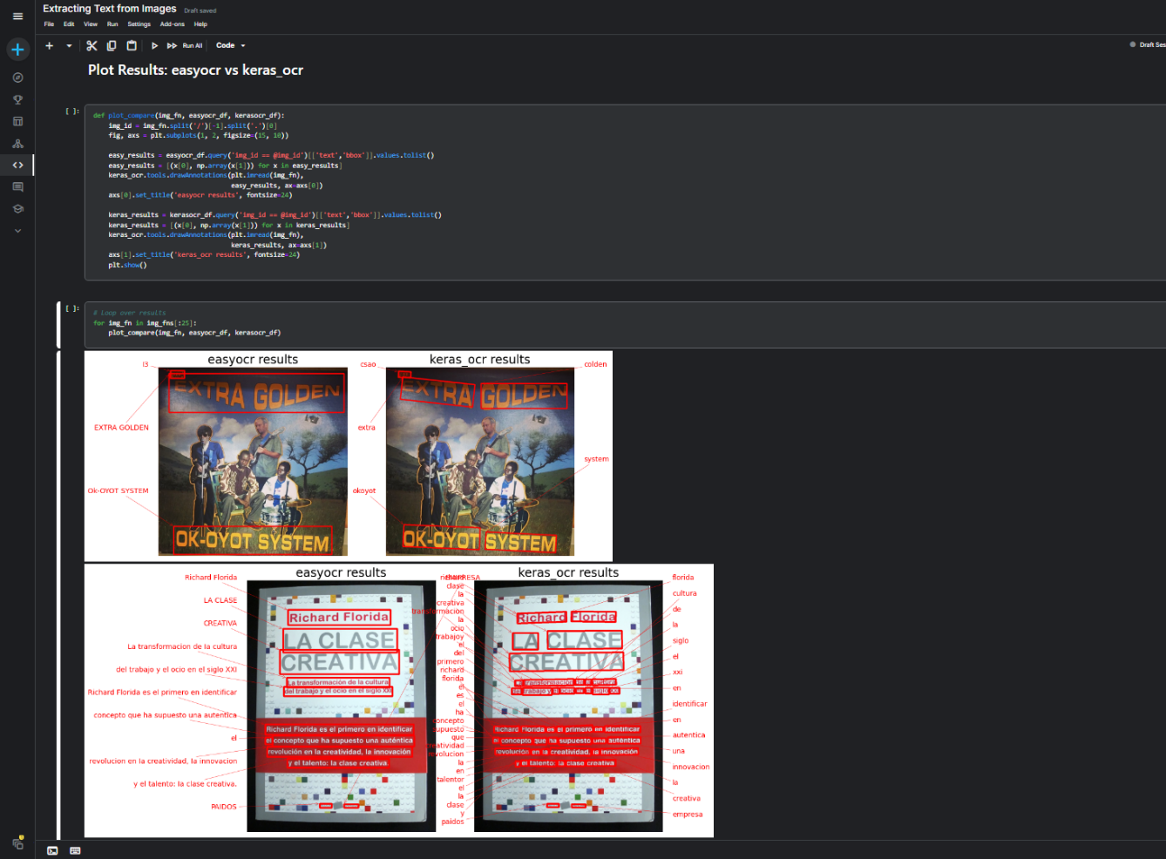
KerasOCR Results
EasyOCR v/s KerasOCR

Slide 14
Conclusion: The multimodal detection system successfully integrates facial expressions and textual data to provide accurate assessments. By leveraging advanced deep learning models for each input type, the project addresses key challenges such as cultural sensitivity and contextual variability. The user-friendly web application enables real-time analysis, making it valuable in various fields like customer service and analytics.
Future Scope: Future enhancements could focus on using larger, more diverse datasets to improve accuracy and incorporating real-time feedback for continuous learning. Exploring techniques such as attention mechanisms and transfer learning could further enhance performance. Additionally, expanding the application to support multiple languages and cultural contexts, while prioritizing ethical considerations and user privacy, will be crucial for broader adoption and effectiveness.

